Slide 2

Introduction to
Data Science
(IT4142E)

Slide 3
Contents
Lecture 1: Overview of Data Science
Lecture 2: Data crawling and preprocessing
Lecture 3: Data cleaning and integration
Lecture 4: Exploratory data analysis
Lecture 5: Data visualization
Lecture 6: Multivariate data visualization
Lecture 7: Machine learning
Lecture 8: Big data analysis
Lecture 9: Capstone Project guidance
Lecture 10+11: Text, image, graph analysis
Lecture 12: Evaluation of analysis results

Slide 4
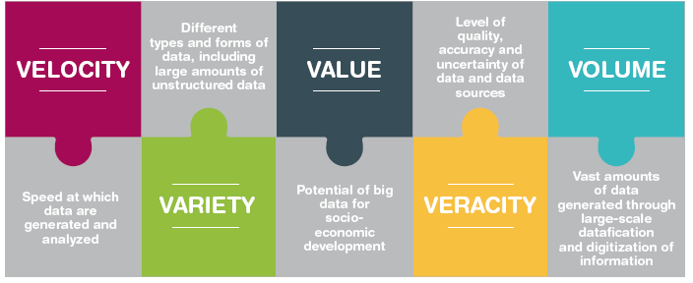
Big data 5'V
Big data is a term for data sets that are so large or complex that traditional data processing application software is inadequate to deal with them (wikipedia)
Notes:
DLL là cáctậpdữliệurấtlớnvà/hoặcrấtphứctạp.
Vượt quá khảnăngkỹthuậtvàlýthuyếttruyềnthống.
DLL có bađặcđiểmquantrọng (3Vs).

Slide 5
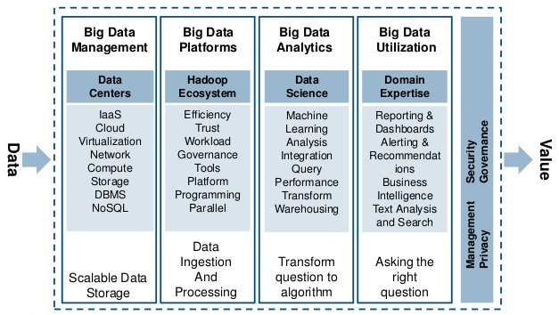
Big data technology stack

Slide 6
Scalable data management
Scalability
Able to manage incresingly big volume of data
Accessibility
Able to maintain efficiciency in reading and writing data (I/O) into data storage systems
Transparency
In distributed environment, users should be able to access data over the network as easily as if the data were stored locally.
Users should not have to know the physical location of data to access it.
Availability
Fault tolerance
The number of users, system failures, or other consequences of distribution shouldn’t compromise the availability.

Slide 7





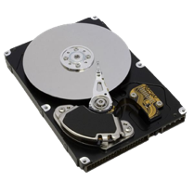

Data I/O landscape
0.1 Gb/s
1 Gb/s or 125 MB/s
Nodes in another rack
CPUs:
Network
10 GB/s
100 MB/s
1 Gb/s or 125 MB/s
Nodes in same rack
600 MB/s
3-12 ms random access
0.1 ms random access
$0.025 per GB
$0.35 per GB

Slide 8
Scalable data ingestion and processing
Data ingestion
Data from different complementing information systems is to be combined to gain a more comprehensive basis to satisfy the need
How to ingest data efficiently from various, distributed heterogeneous sources?
Different data formats
Different data models and schemas
Security and privacy
Data processing
How to process massive volume of data in a timely fashion?
How to process massive stream of data in a real-time fashion?
Traditional parallel, distributed processing (OpenMP, MPI)
Big learning curve
Scalability is limited
Fault tolerence is hard to achive
Expensive, high performance computing infrastructure

Slide 9
Scalable analytic algorithms
Challenges
Big volume
Big dimensionality
Realtime processing
Scaling-up Machine Learning algorithms
Adapting the algorithm to handle Big Data in a single machine.
Eg. Sub-sampling
Eg. Principal component analysis
Eg. feature extraction and feature selection
Scaling-up algorithms by parallelism
Eg. k-nn classification based on MapReduce
Eg. scaling-up support vector machines (SVM) by a divide and-conquer approach
Novel realtime processing architecture
Eg. Mini-batch in Spark streaming
Eg. Complex event processing in Apache Flink

Slide 10
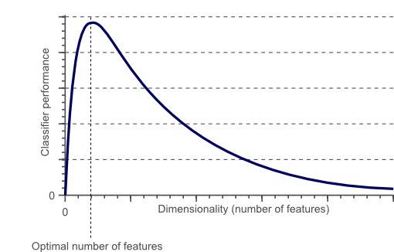
Eg. Curse of dimensionality
The required number of samples (to achieve the same accuracy) grows exponentionally with the number of variables!
In practice: number of training examples is fixed!
=> the classifier’s performance usually will degrade for a large number of features!
In fact, after a certain point, increasing the dimensionality of the problem by adding new features would actually degrade the performance of classifier.

Slide 11
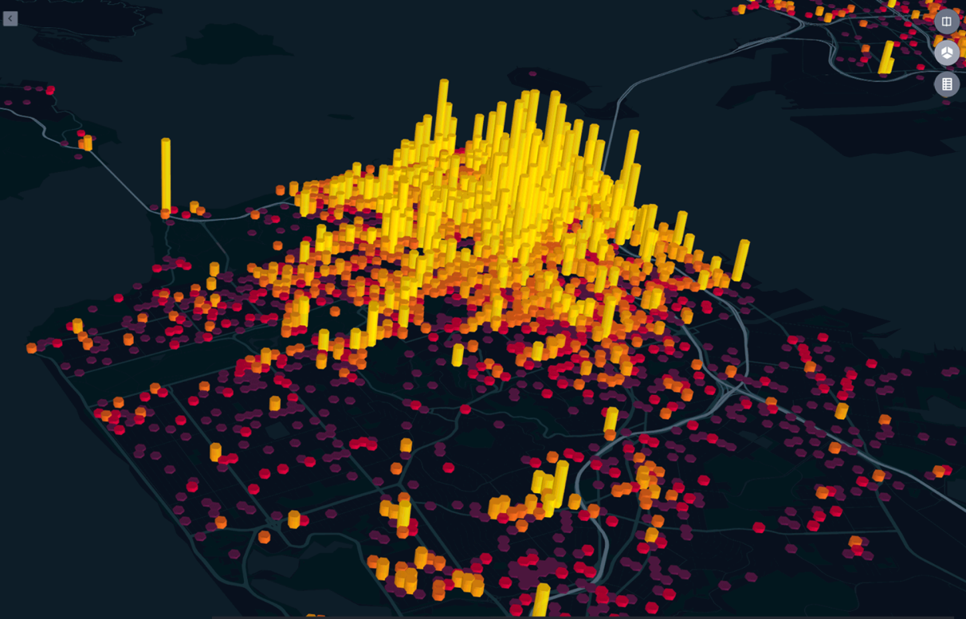
Utilization and interpretability of big data
Domain expertise to findout problems and interprete analytics results
Scalable visualization and interpretability of million data points
to facilitate their interpretability and understanding

Slide 12
Privacy and security

Slide 13
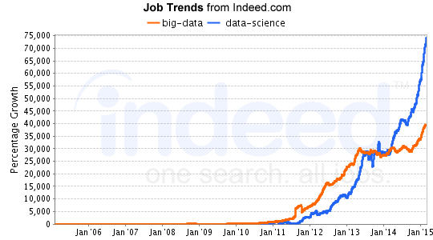
Big data job trends

Slide 14
Talent shortage in big data

Slide 15
Big data skill set

Slide 16
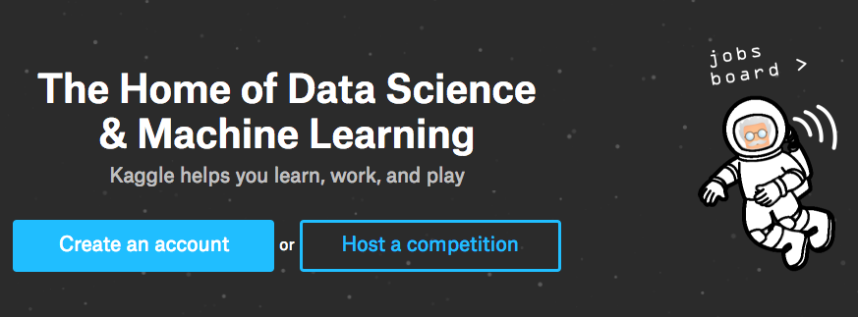
How to land big data related jobs
Learn to code
Coursera
Udacity
Freecodecamp
Codecademy
Math, Stats and machine learning
Kaggle
Hadoop, NoSQL, Spark
Visualization and Reporting
Tableau
Pentahoo
Meetup & Share
Find a mentor
Internships, projects

Slide 17
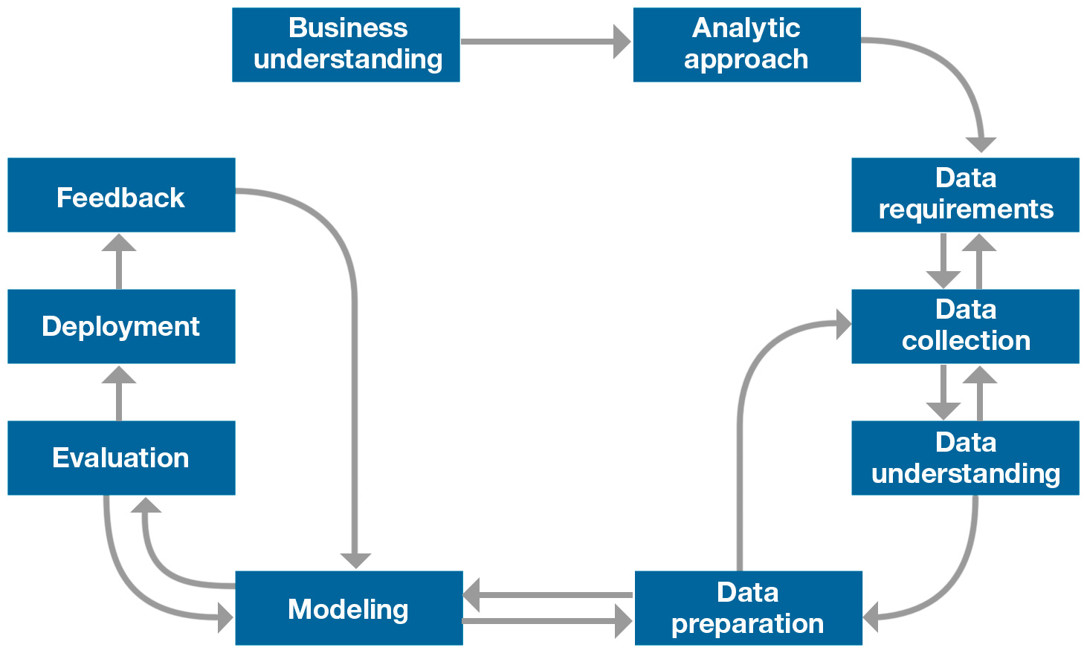
Data science method
1. Formulate a question
4. Product
2. Gather data
3. Analyze data
Source: Foundational Methodology for Data Science, IBM, 2015
Notes:
1. Problem Formulation – First, identify the problem to be solved. This step is easily overlooked. However, many dollars and hours have been spent solving the wrong problems.
2. Obtain The Data – Next, collect new data and/or gather the data that already exists. In almost all cases, this data will need to be transformed and cleansed. It is important to note that this stage does not always involve big data or a data lake.
3. Analysis – This is the part of the process where insight is to be extracted from the data. Commonly, this step will involve creating and optimizing statistical/machine learning models for prediction, but that is not always necessary. Sometimes, the analysis only contains graphs, charts, and basic descriptions of the data.
4. Data Product – The end goal of data science is a data product. The insight from the Analysis phase needs to be conveyed to an end user. The data product might be as simple as a slideshow; more commonly it is a website dashboard, a message, an alert, or a recommendation.
http://www.ibmbigdatahub.com/blog/why-we-need-methodology-data-science

Slide 18

DeepQA: Incremental Progress in Precision and Confidence 6/2007-11/2010
Now Playing in the Winners Cloud
11/2010
4/2010
10/2009
5/2009
Precision
12/2008
8/2008
5/2008
12/2007
Baseline
Notes:
18

Slide 19
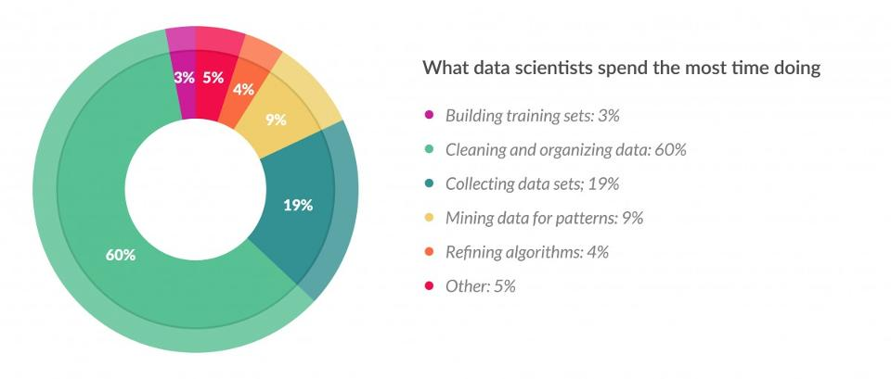
Cleaning big data: most time-consuming, least enjoyable data science task
Data preparation accounts for about 80% of the work of data scientists
source: https://www.forbes.com/

Slide 20
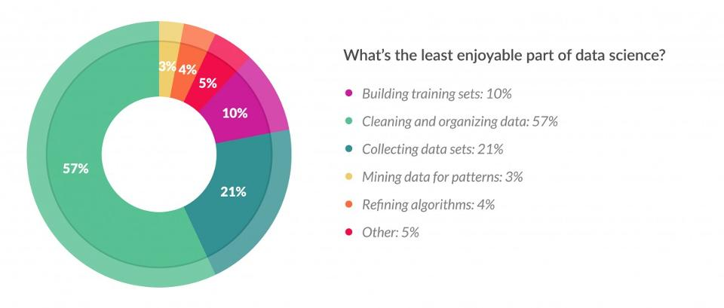
Cleaning big data: most time-consuming, least enjoyable data science task
57% of data scientists regard cleaning and organizing data as the least enjoyable part of their work and 19% say this about collecting data sets.

Slide 21
References
[1] Tiwari, Shashank. Professional NoSQL. John Wiley & Sons, 2011. [2] Lam, Chuck. Hadoop in action. Manning Publications Co., 2010. [3] Miner, Donald, and Adam Shook. MapReduce design patterns: building effective algorithms and analytics for Hadoop and other systems. " O'Reilly Media, Inc.", 2012. [4] Karau, Holden. Fast Data Processing with Spark. Packt Publishing Ltd, 2013. [5] Penchikala, Srini. Big data processing with apache spark. Lulu. com, 2018. [6] White, Tom. Hadoop: The definitive guide. " O'Reilly Media, Inc.", 2012. [7] Gandomi, Amir, and Murtaza Haider. "Beyond the hype: Big data concepts, methods, and analytics." International Journal of Information Management 35.2 (2015): 137-144. [8] Cattell, Rick. "Scalable SQL and NoSQL data stores." Acm Sigmod Record 39.4 (2011): 12-27. [9] Gessert, Felix, et al. "NoSQL database systems: a survey and decision guidance." Computer Science-Research and Development 32.3-4 (2017): 353-365. [10] George, Lars. HBase: the definitive guide: random access to your planet-size data. " O'Reilly Media, Inc.", 2011. [11] Sivasubramanian, Swaminathan. "Amazon dynamoDB: a seamlessly scalable non-relational database service." Proceedings of the 2012 ACM SIGMOD International Conference on Management of Data. ACM, 2012. [12] Chan, L. "Presto: Interacting with petabytes of data at Facebook." (2013). [13] Garg, Nishant. Apache Kafka. Packt Publishing Ltd, 2013. [14] Karau, Holden, et al. Learning spark: lightning-fast big data analysis. " O'Reilly Media, Inc.", 2015. [15] Iqbal, Muhammad Hussain, and Tariq Rahim Soomro. "Big data analysis: Apache storm perspective." International journal of computer trends and technology 19.1 (2015): 9-14. [16] Toshniwal, Ankit, et al. "Storm@ twitter." Proceedings of the 2014 ACM SIGMOD international conference on Management of data. ACM, 2014. [17] Lin, Jimmy. "The lambda and the kappa." IEEE Internet Computing 21.5 (2017): 60-66.

Slide 22
Online courses
https://www.coursera.org/learn/nosql-database-systems
https://who.rocq.inria.fr/Vassilis.Christophides/Big/index.htm
https://www.coursera.org/learn/big-data-introduction?specialization=big-data
https://www.coursera.org/learn/big-data-integration-processing?specialization=big-data
https://www.coursera.org/learn/big-data-management?specialization=big-data
https://www.coursera.org/learn/hadoop
https://www.coursera.org/learn/scala-spark-big-data

Slide 23
Hadoop ecosystem

Slide 24

We need a system that scales
Traditional tools are overwhelmed
Slow disks, unreliable machines, parallelism is not easy
3 challenges
Reliable storage
Powerful data processing
Efficient visualization

Slide 25
What is Apache Hadoop?
Scalable and economical data storage and processing
The Apache Hadoop software library is a framework that allows for the distributed processing of large data sets across clusters of computers using simple programming models. It is designed to scale out from single servers to thousands of machines, each offering local computation and storage. Rather than rely on hardware to deliver high-availability, the library itself is designed to detect and handle failures at the application layer, so delivering a highly-available service on top of a cluster of computers, each of which may be prone to failures (commodity hardware).
Heavily inspired by Google data architecture

Slide 26
Hadoop main components
Storage: Hadoop distributed file system (HDFS)
Processing: MapReduce framework
System utilities:
Hadoop Common: The common utilities that support the other Hadoop modules.
Hadoop YARN: A framework for job scheduling and cluster resource management.

Slide 27
Scalability
Distributed by design
Hadoop can run on cluster
Individual servers within a cluster are called nodes
each node may both store and process data
Scale out by adding more nodes to increase scalability
Up to several thousand nodes

Slide 28
Fault tolerance
Cluster of commodity servers
Hardware failure is the norm rather than the exception
Built with redundancy
File loaded into HDFS are replicated across nodes in the cluster
If a node failed, its data is re-replicated using one of the copies
Data processing jobs are broken into individual tasks
Each task takes a small amount of data as input
Parallel tasks execution
Failed tasks also get rescheduled elsewhere
Routine failures are handled automatically without any loss of data

Slide 29
Hadoop distributed file system
Provides inexpensive and reliable storage for massive amounts of data
Optimized for big files (100 MB to several TBs file sizes)
Hierarchical UNIX style file system
(e.g., /hust/soict/hello.txt)
UNIX style file ownership and permissions
There are also some major deviations from UNIX
Append only
Write once read many times

Slide 30
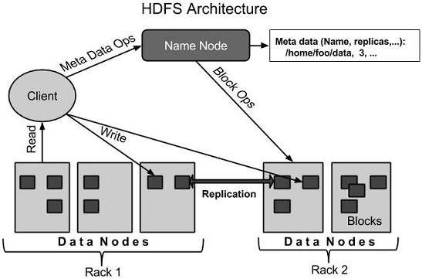
HDFS Architecture
Master/slave architecture
HDFS master: namenode
Manage namespace and metadata
Monitor datanode
HDFS slave: datanode
Handle read/write the actual data

Slide 31
HDFS main design principles
I/O pattern
Append only → reduce synchronization
Data distribution
File is splitted in big chunks (64 MB)
→ reduce metadata size
→ reduce network communication
Data replication
Each chunk is usually replicated in 3 different nodes
Fault tolerance
Data node: re-replication
Name node
Secondary namenode
Enqury data nodes instead of complex checkpointing scheme

Slide 32
Data processing: MapReduce
MapReduce framework is the Hadoop default data processing engine
MapReduce is a programming model for data processing
it is not a language, a style of processing data created by Google
The beauty of MapReduce
Simplicity
Flexibility
Scalability
Notes:
The power of MapReduce lies in its ability to scale to 100s or 1000s of computers, each with several processor cores
How large an amount of work?
Web-Scale data on the order of 100s of GBs to TBs or PBs
It is likely that the input data set will not fit on a single computer’s hard drive
Hence, a distributed file system (e.g., Google File System- GFS) is typically required

Slide 33
a MR job = {Isolated Tasks}n
MapReduce divides the workload into multiple independent tasks and schedule them across cluster nodes
A work performed by each task is done in isolation from one another for scalability reasons
The communication overhead required to keep the data on the nodes synchronized at all times would prevent the model from performing reliably and efficiently at large scale

Slide 34
Data Distribution
In a MapReduce cluster, data is usually managed by a distributed file systems (e.g., HDFS)
Move code to data and not data to code
Input data: A large file
Node 1
Node 2
Node 3
Chunk of input data
Chunk of input data
Chunk of input data
Notes:
By processing a file in chunks, we allow several map tasks to operate on a single file in parallel. If the file is very large, this can improve performance significantly through parallelism

Slide 35
Keys and Values
The programmer in MapReduce has to specify two functions, the map function and the reduce function that implement the Mapper and the Reducer in a MapReduce program
In MapReduce data elements are always structured as key-value (i.e., (K, V)) pairs
The map and reduce functions receive and emit (K, V) pairs
Input Splits
Intermediate Outputs
Final Outputs
(K, V) Pairs
(K’, V’) Pairs
(K’’, V’’) Pairs
Map Function
Reduce Function
Notes:
Every value is identified by an associated key

Slide 36
Partitions
A different subset of intermediate key space is assigned to each Reducer
These subsets are known as partitions
Different colors represent
different keys (potentially)
from different Mappers
Partitions are the input to Reducers
Notes:
In MapReduce, intermediate output values are not usually reduced together
All values with the same key are presented to a single Reducer together

Slide 37
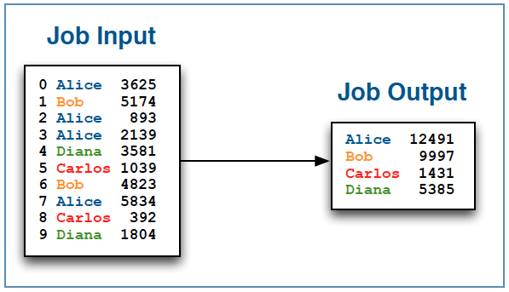
MapReduce example
Input: text file containing order ID, employee name, and sale amount
Output: sum of all sales per employee

Slide 38
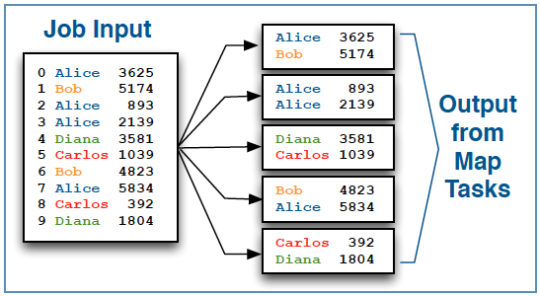
Map phase
Hadoop splits job into many individual map tasks
Number of map tasks is determined by the amount of input data
Each map task receives a portion of the overall job input to process
Mappers process one input record at a time
For each input record, they emit zero or more records as output
In this case, the map task simply parses the input record
And then emits the name and price fields for each as output
Map phase

Slide 39
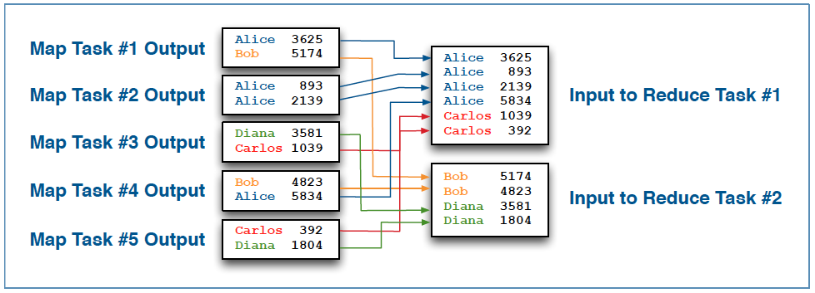
Hadoop automatically sorts and merges output from all map tasks
This intermediate process is known as the shuffle and sort
The result is supplied to reduce tasks
Shuffle & sort phase

Slide 40
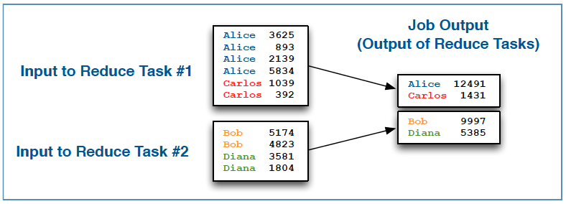
Reduce phase
Reducer input comes from the shuffle and sort process
As with map, the reduce function receives one record at a time
A given reducer receives all records for a given key
For each input record, reduce can emit zero or more output records
Our reduce function simply sums total per person
And emits employee name (key) and total (value) as output
Reduce phase

Slide 41
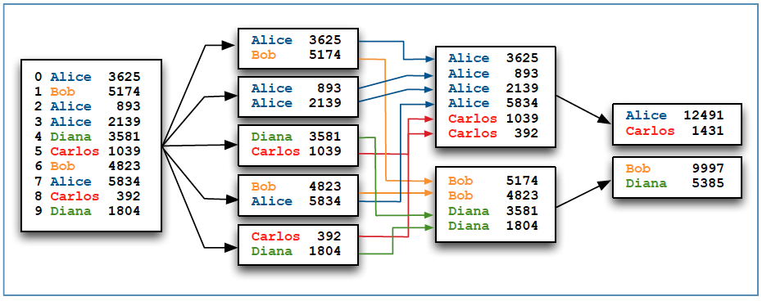
Data flow for the entire MapReduce job

Slide 42
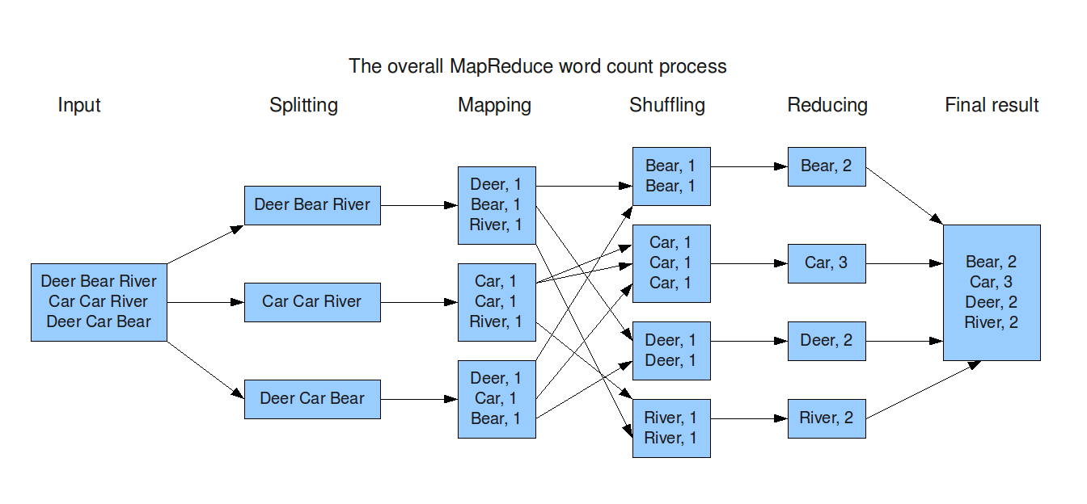
Word Count Dataflow

Slide 43
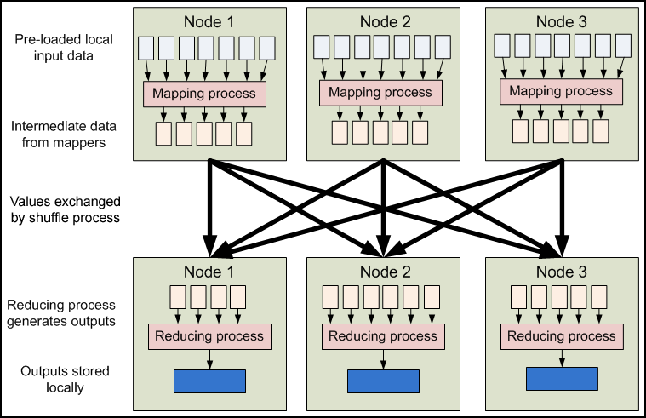
MapReduce - Dataflow

Slide 44
Map reduce life cycle

Slide 45
Hadoop ecosystem
Many related tools integrate with Hadoop
Data analysis
Database integration
Workflow management
These are not considered ‘core Hadoop’
Rather, they are part of the ‘Hadoop ecosystem’
Many are also open source Apache projects

Slide 46

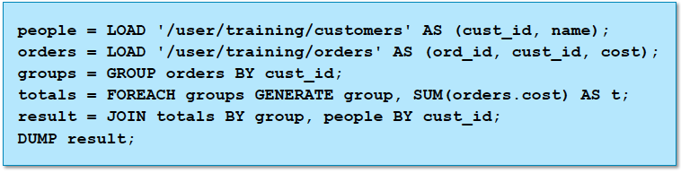
Apache Pig
Apache Pig builds on Hadoop to offer high level data processing
Pig is especially good at joining and transforming data
The Pig interpreter runs on the client machine
Turns PigLatin scripts into MapReduce jobs
Submits those jobs to the cluster

Slide 47

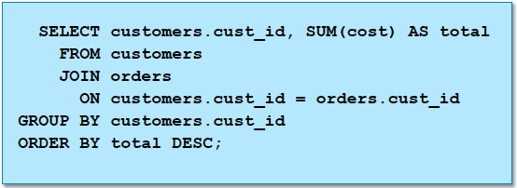
Apache Hive
Another abstraction on top of MapReduce
Reduce development time
HiveQL: SQL-like language
The Hive interpreter runs on the client machine
Turns HiveQL scripts into MapReduce jobs
Submits those jobs to the cluster

Slide 48

Apache Hbase
HBase is a distributed column-oriented data store built on top of HDFS
Is considered as the Hadoop database
Data is logically organized into tables, rows and columns
terabytes, and even petabytes of data in a table
Tables can have many thousands of columns
Scales to provide very high write throughput
Hundreds of thousands of inserts per second
Fairly primitive when compared to RDBMS
NoSQL : There is no high/level query language
Use API to scan / get / put values based on keys

Slide 49
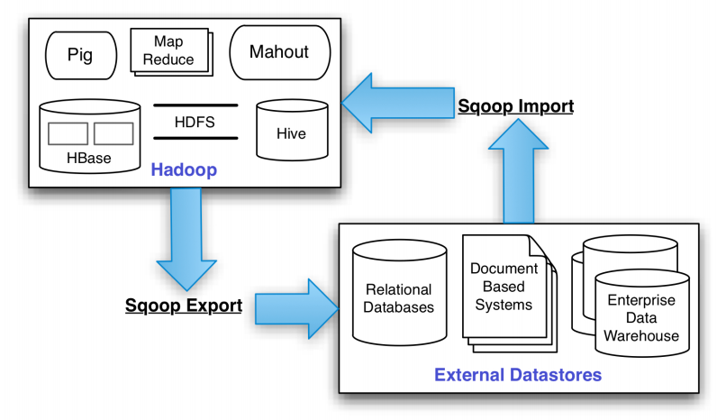

Apache sqoop
Sqoop is a tool designed for efficiently transferring bulk data between Apache Hadoop and structured datastores such as relational databases.
It can import all tables, a single table, or a portion of a table into HDFS
Via a Map/only MapReduce job
Result is a directory in HDFS containing comma/delimited text files
Sqoop can also export data from HDFS back to the database

Slide 50
Apache Kafka
Producer
Producer
Producers
Kafka Cluster
Broker
Broker
Broker
Broker
Zookeeper
Consumers
Offsets
Consumer
Consumer
Kafka decouples Data Pipelines
Notes:
Kafka is a pub/sub messaging system that can decouple your data pipelines. Most of you are probably familiar with it’s history at LinkedIn and they use it as a high throughput relatively low latency commit log. It allows sources to push data without worrying about what clients are reading it. Note that producer push, and consumers pull. Kafka itself is a cluster of brokers, which handles both persisting data to disk and serving that data to consumer requests.

Slide 51

Apache Oozie
Oozie is a workflow scheduler system to manage Apache Hadoop jobs.
Oozie Workflow jobs are Directed Acyclical Graphs (DAGs) of actions.
Oozie supports many workflow actions, including
Executing MapReduce jobs
Running Pig or Hive scripts
Executing standard Java or shell programs
Manipulating data via HDFS commands
Running remote commands with SSH
Sending e/mail messages

Slide 52

Apache Zookeeper
Apache ZooKeeper is a highly reliable distributed coordination service
Group membership
Leader election
Dynamic Configuration
Status monitoring
All of these kinds of services are used in some form or another by distributed applications

Slide 53
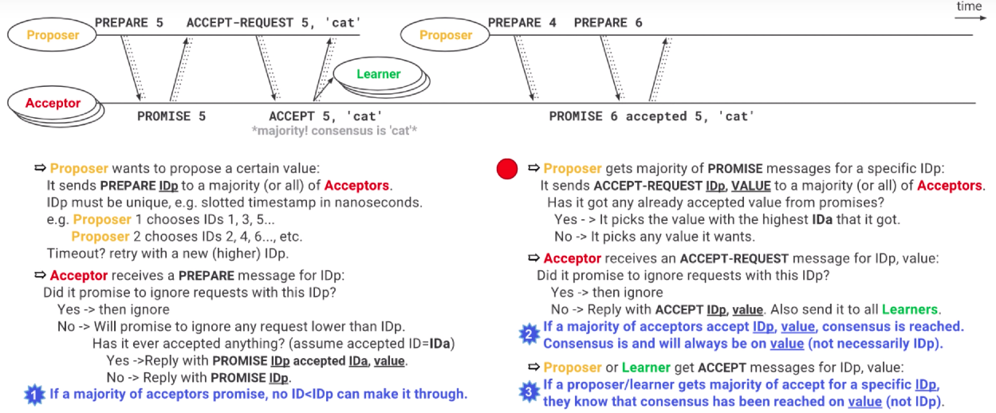
PAXOS algorithm
https://www.youtube.com/watch?v=d7nAGI_NZPk

Slide 54
YARN – Yet Another Resource Negotiator
Nodes have "resources" – memory and CPU cores – which are allocated to application when requested
Moving beyond Map Reduce
MR and non-MR running on the same cluster
Most jobtracker functions moved to application masters
HADOOP 1.0
HADOOP 2.0
MapReduce
(data processing)
Others
(data processing)
MapReduce
(cluster resource management
& data processing)
YARN
(cluster resource management)
HDFS
(redundant, reliable storage)
HDFS
(redundant, reliable storage)

Slide 55
YARN execution

Slide 56
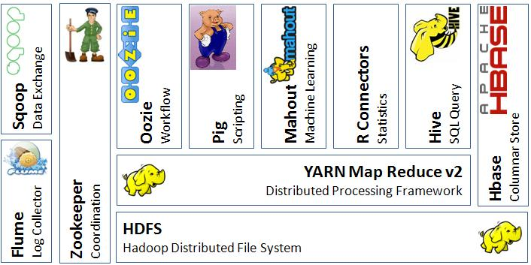
Big data platform: Hadoop ecosystem

Slide 57
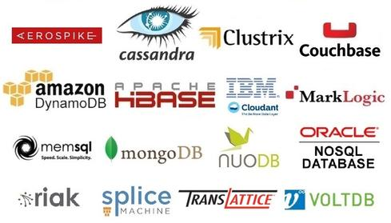
Big data management

